Slide 1
Community Wildfire Defense Grant (CWDG) Program Webinar for Applicants
(Updated 08/03/2023)

Slide 2
Today's Agenda
Overview of Program Changes from Round 1
CWDG Program Overview
CWDG Application Eligibility
CWDG Application
CWDG Application and Portal Information
Grants and Agreements
National Tools
Timeline

Slide 3
Overview of Program Changes from Round 1

Slide 4
Grant Application Portal
All four Notice for Funding Opportunities (NOFOs) are using the https://cwdg.forestrygrants.org/ portal for application submittal
For Round 2, the NOFOs are advertised in grants.gov as required
NOFOs then point applicants to apply in the cwdg.forestrygrants.org portal, which is where applicants will find the actual application form
Applicants are required to submit UEI # and certify they have an active SAM.gov registration

Slide 5
Low Income Communities
Applicants for Round 2 now have access to community-level data for low-income, verses county-level used in Round 1
A significant concern was the inability to analyze income status at a scale smaller than county-level
Round 2 data is available for county, Tribe, and community income levels
Low-income is now based upon having a median household income less than 80% in comparison to the state, as well as national, median incomes, verses only state level incomes used during Round 1 (mitigating bias against states with a lower overall income)
The Wildfire Risk to Communities project team developed a new, easy-to-use web tool that provides CWDG eligibility and scoring data for all U.S. communities, counties, and Tribal areas. The tool will make it easier for underserved and lower-capacity communities to find the necessary data required to apply for grants. https://wildfirerisk.org/cwdg-tool

Slide 6
Underserved Communities
The determination of underserved community for Round 2 will migrate from the Social Vulnerability Index to the Climate and Economic Justice Screening Tool
CEJST was still in development during Round 1
This conversion will comply with EO #13985
The Climate and Economic Justice Screening Tool uses datasets that are indicators of burdens in eight categories: climate change, energy, health, housing, legacy pollution, transportation, water and wastewater, and workforce development. The tool uses
this information to identify communities that are experiencing these burdens. These are the communities that are disadvantaged because
they are overburdened and underserved

Slide 7
Underserved Communities
Communities that meet the Low-Income definition are also considered underserved and therefore eligible for the match waiver
In addition, the NOFO is updated to include waivers for Tribes, Pacific Islands and the USVI
As reference, Executive Order 13985: "Advancing racial Equity and Support for Underserved Communities Through the Federal Government": The term "underserved communities" refers to populations sharing a particular characteristic, as well as geographic communities, that have been systematically denied a full opportunity to participate in aspects of economic, social, and civic life...

Slide 8
Application Period
Application period will be open for 90 days
To allow applicants more time to develop proposals, the application period for Round 2 will be 90 days, verses 60 days used in Round 1
The Application Period opened July 31st and will close October 31st, 2023

Slide 9
Prioritization of CWPPs
The CWDG workgroup suggested dedicating a minimum amount of Round 2 funding to target applications requesting the creation of CWPPs, or revisions to existing CWPPs, so long as they meet a minimum score.
Only 3.4% of funding in Round 1 went to applicants requesting the development or enhancement of CWPPs
To apply for CWDG, Communities must have a CWPP to apply project funding however, not every community has a CWPP creating disparity in funding opportunities
Feedback from Multiple applicants and states asked for priority for the development of CWPPs during the early years of the CWDG funding. By doing so, these communities can do follow-up submissions for project implementation before the depletion of CWDG funding opportunities
Minimum score TBD based upon an analysis of applications and scores

Slide 10
Use of Two Scoring Rubrics
Separate scoring rubrics are developed for CWPPs verses Projects
Separate scoring rubrics are in place for CWPPs verses implementation projects allowing for better clarification to both applicants and reviewers regarding the information needed to answer questions

Slide 11
CWDG Program Overview

Slide 12
Authorizing Legislation
Infrastructure, Investment and Jobs Act, Section 40803(f) authorizes the Secretary of Agriculture, through the USDA Forest Service, to establish a program, which shall be separate from the program established under section 203 of the Robert T. Stafford Disaster Relief and Emergency Assistance Act (42 U.S.C. 5133), under which the Secretary of Agriculture, in cooperation with the States, shall award grants to
at-risk communities, including Indian Tribes —
(A) to develop or revise a community wildfire protection plan; and
(B) to carry out projects described in a community wildfire protection plan that is not more than 10 years old

Slide 13
Program Purpose
The CWDG is intended to help communities in the wildland urban interface (WUI) implement the three goals of the National Cohesive Wildland Fire Management Strategy (Cohesive Strategy):
Resilient Landscapes: Landscapes, regardless of jurisdictional boundaries, are resilient to fire, insect, disease, invasive species and climate change disturbances, in accordance with management objectives
Fire Adapted Communities: Human populations and infrastructure are as prepared as possible to receive, respond to, and recover from wildland fire
Safe, Effective, Risk-based Wildfire Response: All jurisdictions participate in making and implementing safe, effective, efficient risk-based wildfire management decisions

Slide 14
Program Administration
Grants are offered on a competitive basis through Notices of Funding Opportunity (NOFO) posted on www.grants.gov
One NOFO per each of the three regional state forestry organizations (West, Northeast/Midwest, and Southeast)
One NOFO for Tribes
All applications will be submitted on https://cwdg.forestrygrants.org/

Slide 15
Program Administration (continued)
A grant review panel will be convened in each of the state forestry organization regions to review, score, and rank grant applications received within their respective state forestry organization regions
USDA Forest Service (USFS) will organize a grant review panel to review, score, and rank the grant applications received from Tribes
Normalization process
Normalization is a process where raw scores undergo a statistical adjustment so that scores from different reviewers can be compared on a common scale.

Slide 16
Funding
Minimum and Maximum Funding Levels
There is no minimum Federal funding limit for projects under CWDG
The maximum amount of Federal funding awarded to any one community or Tribal entity:
$250,000 for creating or updating a Community Wildfire Protection Plan
$10 million for a project described within a Community Wildfire Protection Plan (CWPP can be no more than 10 years old / 2013 or newer)

Slide 17
Funding (continued)
Required Matching Funds:
Proposals to develop or update a CWPP, required match is 10%
Proposals to implement projects described in a CWPP, required match is 25%
Underserved communities are eligible to request a match waiver, as well as Tribes, Pacific Island Territories, and the USVI

Slide 18
Additional Process Elements
Lead Agency or Organization:
All applications must identify the lead agency or organization
The lead agency may pass funds to other partners performing work as relevant
Grant Timeframes: Projects must be completed within five (5) years
Reporting:
Quarterly Financial reports
Annual Project Performance reports
Performance report shall include a spatial data component

Slide 19
CWDG Application Eligibility

Slide 20
Applicant Eligibility
Eligibility
At-risk Community
Two options listed in NOFOs to determine if community is an “at-risk community”
The following entities are eligible to submit a project proposal for funding:
Units of local governments representing communities located in an area at risk of wildfires
Indian Tribes
Alaska Native Corporations
Non-profit organizations such as homeowner associations that assist communities
State forestry agencies
For-profit entities are not eligible to apply for a grant under this program.
Other considerations
Applying for multiple communities
Grant management by non-profits or other organizations

Slide 21
Eligible Lands
Eligible applicants may apply for grant funding for a project proposal to be conducted on lands with the following ownership types, as long as the project proposal directly reduces wildfire risk to a community:
Private lands
Local government
Homeowner associations
State government
Tribal/Alaska Native Corporation (includes Trust lands)
Federal lands are not eligible for this funding opportunity, with the exception of federal Tribal trust lands

Slide 22
Priority Projects
Priority will be given to project proposals that:
Are located in an area identified as having high or very high wildfire hazard potential, and/or
Benefit a low-income community, and/or
Are located in a community impacted by a severe disaster within the previous 10 years
Supporting documentation or link to documentation must be provided

Slide 23
Project Objectives
Projects must advance objectives and priorities identified in a CWPP not more
than 10 years old (2013 or newer)
A project must be designed to achieve one or more of the following objectives:
Assist a community with planning to address management of wildfire risk
Assist a community with mitigation measures or actions to reduce wildfire risk

Slide 24
Multiple Community Applications
Separate Projects in separate Communities:
A separate narrative form and included budget will need to be filled out for each community for purposes of determining eligibility, prioritization, and ranking of the separate projects
Single Project in multiple communities:
For an application consisting of a single project that spans multiple communities, the project can be applied for and described within the same application and narrative form

Slide 25
Project Types
CWPP Development or Revision
CWPP Implementation
Planning (Codes, smoke readiness, etc.)
Wildfire Prevention and Mitigation Education/Outreach
Reduce Hazardous Fuels / Restore Fire-adapted Ecosystems
See NOFO's for examples of Eligible and Ineligible project types

Slide 26
CWPP Development or Revision
Eligible Projects
Creation of a CWPP or development of a wildfire section for a hazard mitigation plan.
Update of an existing CWPP/hazard mitigation plan (Existing plan must be over five (5) years old (older than 2018))
Ineligible Projects
Creation and/or update of Forest Stewardship Plans

Slide 27
Eligible “Planning” Project Examples
Contract support to assist a community with developing building codes, zoning ordinances, or land use planning
Direct staff funding support to assist a community with developing building codes, zoning ordinances, or land use planning
Tabletop or functional exercises to test effectiveness of community wildfire planning
Plan and address public health and safety effects of smoke and mitigation from wildfire and projects that use prescribed fire (“Smoke Ready” efforts)
Direct staff support for community wildfire mitigation leadership/coordination
Training in the use of proven effective mitigation practices, such as the Forest Service’s mitigation best practices
Direct staff support to assist in creation of a local or regional mitigation partnership

Slide 28
Ineligible “Planning” Project Examples
GIS and database systems unless in support of a CWPP, wildfire risk reduction planning or fuels mitigation initiative or project
Creation and/or update of Forest Stewardship Plans
Economic development projects
Small business start-up funding
Research and development projects

Slide 29
Eligible “Wildfire Prevention and Mitigation Education/Outreach” Project Examples
Firewise USA© or similar programs outreach to communities and property owners
Fire education presentations such as Project Learning Tree
Property inspections and/or assessments
Training to conduct property inspections and/or assessments
Implementation of WUI Structure / Parcel / Community Fire Hazard Mitigation Methodology (HMM) for community hazard reduction
Training for Traditional Ecological Knowledge of fire, Cultural Burning, Identification and protection of culturally significant plants, sacred site protection

Slide 30
Ineligible “Wildfire Prevention and Mitigation Education/Outreach” Project Example
Printing of paper-based materials without an organized outreach/education program

Slide 31
Eligible “Hazardous Fuels Reduction / Fire-adapted Ecosystems Restoration” Project Examples
Defensible space around homes, businesses, and other structures
Development, creation, and/or maintenance of fuel breaks and fire breaks, including shaded fuel breaks
Fuels reduction beyond defensible space adjacent to at- risk communities
Removal of standing woody vegetation by cutting, piling and burning
Removal of standing woody vegetation by cutting and chipping

Slide 32
Eligible “Hazardous Fuels Reduction / Fire-adapted Ecosystems Restoration” Project Examples (continued)
Removal of standing woody vegetation using a mechanical mulcher or masticator type equipment mounted on mobile equipment
Reduction of hazardous fuels through the application of prescribed fire
Vegetation management (pruning, mowing, chemical treatment, grazing), including rights-of-ways for roads
Maintenance of fuels projects. Up to two (2) maintenance treatments allowed per project during the grant term

Slide 33
Eligible “Hazardous Fuels Reduction / Fire-adapted Ecosystems Restoration” Project Examples (continued)
Monitoring components of projects for effectiveness (must have established baseline)
Prescribed fire training, including training on smoke management associated with prescribed fires
Design and installation of dry hydrants and cisterns
Purchase of equipment for brush/fuel disposal, such as air curtain burner/trench burner (be aware of permitting requirements for these devices, which are an eligible cost)

Slide 34
Eligible “Hazardous Fuels Reduction / Fire-adapted Ecosystems Restoration” Project Examples (continued)
Purchase of mechanical equipment that meets, or does not exceed, the following requirements:
Brush/woodchippers that are towable or mountable to a skid steer, compact track loader or tractor with a maximum chipping capacity of no more than 15 inches
Self-propelled forestry mulchers up to a maximum 200 horsepower
Forestry mulcher attachments designed for skid steers, compact track loaders, excavators or crawler dozers
Heavy duty brush mowers that can be utilized for maintaining road rights-of-ways and fire breaks
Trailers necessary to transport equipment that is determined eligible in this section, including box-type trailers to store and transport prescribed fire equipment

Slide 35
Eligible “Hazardous Fuels Reduction / Fire-adapted Ecosystems Restoration” Project Examples (continued)
Purchase of the following equipment and supplies to support the use of prescribed fire:
Personal protection equipment, including fire shelters and N95 filtering face respirators
Drip torches
Wildland hand tools
Backpack blowers
Chainsaws
Portable wildfire pumps
Wildland hose
Portable folding water tanks
Cache of air filtration units for use by at-risk individuals in the public

Slide 36
Ineligible “Hazardous Fuels Reduction / Fire-adapted Ecosystems Restoration” Project Examples
Capital improvements including construction/infrastructure (building remodel, bridges, road construction, water
system development). Dry hydrants are eligible for funding.
Home hardening, including but not limited to:
Roof upgrades or replacements
Fire resistant siding
Metal gutters and vents
Fire suppression training (unless course is a requirement for prescribed fire qualifications)
Fire suppression equipment and apparatus
Drones

Slide 37
Other Considerations
If there is an implementation project that is not covered in a CWPP, such as developing a smoke ready program for your community, consider updating your CWPP this year and applying for a grant for that project next year. The examples listed previously may help you recognize any gaps in your existing CWPP.
You can apply for an implementation grant for projects already identified in your CWPP, and apply for a CWPP update grant separately (if assistance is needed), in the same year.

Slide 38
CWDG Application

Slide 39
Submitting Applications
Notice of Funding Opportunities are posted on grants.gov:
Tribes NOFO: USDA-FS-2023-CWDG-TRIBES
Southern NOFO: USDA-FS-2023-CWDG-SGSF
Northeast/Midwest NOFO: USDA-FS-2023-CWDG-NEMW
West NOFO: USDA-FS-2023-CWDG-CWSF
Applications will be submitted through cwdg.forestrygrants.org
Reach out to your point of contact listed in the NOFOs for an application link
Tribal entities may submit applications via any NOFO
Both CWPP and Project Implementation use the same application (but have separate scoring rubrics)

Slide 40
GIS Coordinates
Please include enough coordinates/description to be able to represent the general area of the impact of the project for which you are applying
For point-based projects, please include a reference point and description
For fuel treatments, please include enough coordinates to ascertain a general boundary of the area being treated. If unsure of boundaries, please include a reference point and the planned acreage to be treated under the description
For CWPP development, please include a description of the planning area and type (municipality boundary, fire response district, township, etc.)
GIS Coordinates: Ref. Point Name: Lat/Long:
Description: Area Name:
Boundary Lat/Longs: Description:

Slide 41
Scoring Criteria and Prioritization Factors
There are two separate rubrics; one for CWPP Development or Revision and one for Project Implementation
NOFOs contain each of the scoring rubrics
Total Points and scoring criteria remain the same as Round 1:
Project Description (0-10 points)
Project Budget Explantation (0-10 points)
Accomplishments (0-10 points)
Collaboration (0-10 points)
Landscape Impacts (0-10 points)
Project Sustainability (0-10 points)
Low-Income Community (10 points or 0 points)
Severe Disaster Impact (10 points or 0 points)
Wildfire Hazard Potential (20 points or 0 points)

Slide 42
Project Description (10 points)
Clearly define the scope of the project, what the project proposes to accomplish, why it is important, and how it supports the Cohesive Wildland Fire Management Strategy and relevant State Forest Action Plan (or equivalent Tribal plan).
Provide a comprehensive but succinct overview of the proposed project that includes basic details of who is doing what, where, and why this is important.
Explain how the project is described in a CWPP (or acceptable alternative as described in the NOFO).
Specify if benefits to traditionally under-served or marginalized audiences are a component of the work.

Slide 43
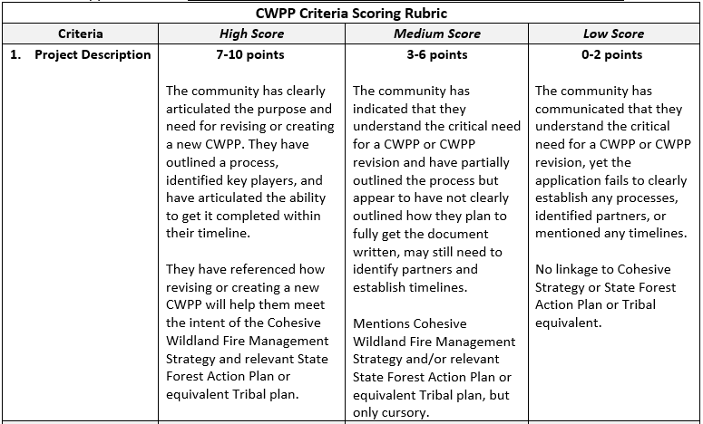
Project Description (10 points)

Slide 44
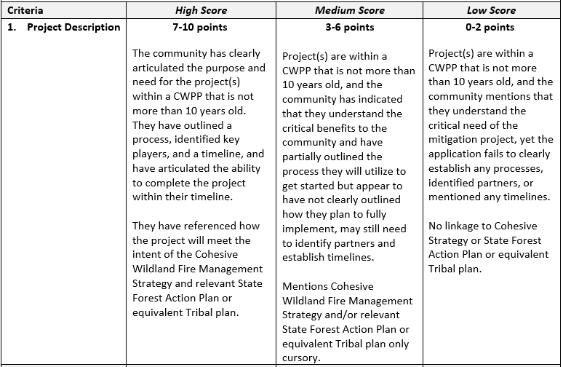
Project Description (10 points)

Slide 45
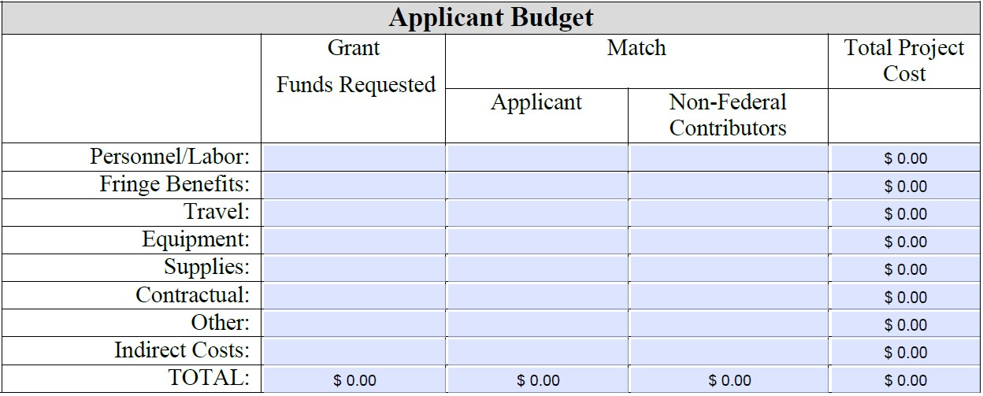
Applicant Budget (10 points)
Clearly explain how the budget will be spent by line item, sources of match, and how expenditures are applicable and relevant to the goals and objectives of the project.
The budget narrative must describe how the grant funds will be spent with specific detail for each grant expenditure.
It must describe how expenditures are applicable and relevant to the goals and objectives of the project.
A project proposal must also show how the applicant will meet matching requirements or qualify for a waiver. If qualified for a waiver, you do not need to show funding in the match column.

Slide 46
Accomplishments (10 points)
A proposal must clearly define how a project will be accomplished, timelines and milestones, as well as measures and metrics
Examples include:
How the selected objectives will lead to measurable outcomes for community wildfire risk reduction
How the applicant will measure progress towards those outcomes (such as, acres treated to reduce hazardous fuels, change in fire regime)
The proposed metrics for measuring progress, which must be specific, measurable, achievable, realistic, and timely

Slide 47
Accomplishments -
Measurable Outcomes
A sample Measurable Outcomes table is available in the
application pdf form to guide applicants on the types of accomplishments to describe in the accomplishments narrative
For projects selected for funding, reporting accomplishments will be required for the annual performance reports
You may also list additional specific measurable results that show how the Federal investment will lead to outcomes on the landscape
In the accomplishments narrative section, describe less quantifiable return on investments

Slide 48
Collaboration (10 points)
The application should clearly define collaborative elements including support from partners, agencies, landowners, and communities
A project proposal must identify partners that will be actively engaged in carrying out the project and add value to project planning and implementation, with a description of each partner’s role
Collaboration may be qualitative in nature, and the contribution of a partner may be more than the number of partners

Slide 49
Landscape Impacts (10 points)
The application should clearly define:
The scale of the project including relationships with past, present, or future projects that, when combined, offer more benefits than when taken individually
The overall landscape that the project influences, in addition to the defined project area, should be clearly described, as well as the land ownerships within the area
Specify areas targeted for planning or mitigation
Clearly describe each proposed activity and include details on where they will be occurring
Include the approximate number of structures that will benefit from the proposed action

Slide 50
Project Sustainability (10 points)
The application should clearly define how or if the project will sustain itself after the grant period is over
Any steps or plans that will be carried out to continue the project benefits beyond the life of the grant should be described, as well as who or what organizations will be responsible

Slide 51
Low-Income Community(10 points)
The application should clearly demonstrate and document whether the project benefits a low-income community, as defined.

Slide 52
Affected by a Severe Disaster (10 points)
The application should clearly demonstrate and document:
Whether the project benefits a community that has been impacted by a severe disaster within the previous ten (10) years
Clearly exhibit how the severe disaster increased wildfire risk and/or hazard and was of a scale and scope to have had landscape impacts (refer to definition in the NOFO)
Simply listing a disaster will not suffice, you must explain how this disaster has impacted the community’s wildfire risk and hazard (not all disasters will qualify for points if it cannot be shown they have influenced the community’s risk or hazard)

Slide 53
Examples of Severe Disaster
Examples of how a Severe Disaster may impact an area resulting in increased risk or hazard associated with wildfire:
Ice storm, windstorm, hurricane, or similar event causing severe vegetation damage resulting in accumulation of dead and downed fuels, leading to increased risk associated with wildfire.
Flood, landslide, or other event damage impacting transportation infrastructure, resulting in restricted egress, longer evacuation times for communities.
Past wildfires contributing to conditions which result in more rapid and/or more intense fire behavior:
Increased grass and light fuel loading leading to increased rates of spread.
Species change to invasives with increased fire behavior.
Increased dead / heavy fuel loading due to heavy mortality in previous fires leading to higher intensity fires.
Past wildfire damage to wildfire response infrastructure, such as communication networks, fire detection systems, air quality monitoring systems.
Past wildfires reducing watershed capacity (through soil impermeability, lack of cover for snow holding, etc), increasing potential for drought related effects resulting in increased fire risk / fire behavior.
Forest health related issues, such as insect outbreaks or disease, leading to increased risk of high severity wildfire.

Slide 54
Area of Wildfire Hazard Potential (20 points)
The application should clearly demonstrate and document whether the project is located in an area identified as having high or very high wildfire hazard potential as defined by a local, state, Tribal, regional, or national wildfire hazard potential assessment

Slide 55
What Factors Influence High Scores
Detailed narratives including the following:
How project will impact community immediately
How project will impact community long term
Plan for how funds will be spent
Examples of prior incidents that the project would have been applicable
Timeline / Project Plan looking forward
Described how agency will partner with others
Uses examples of prior and current partnerships

Slide 56
What Factors Influence Low Scores
Lack of detail in descriptions
Short narratives
Does not define where money will be spent
Does not use examples when listing accomplishments / collaboration
Lacking clear plan for sustainability
Does not include examples of landscape impacts and how the project will change the effects

Slide 57
CWDG Application and Portal Information

Slide 58
CWDG Application Process
Contact your state/island/territory point of contact
Request an application link
UEI# and active sams.gov registration

Slide 59
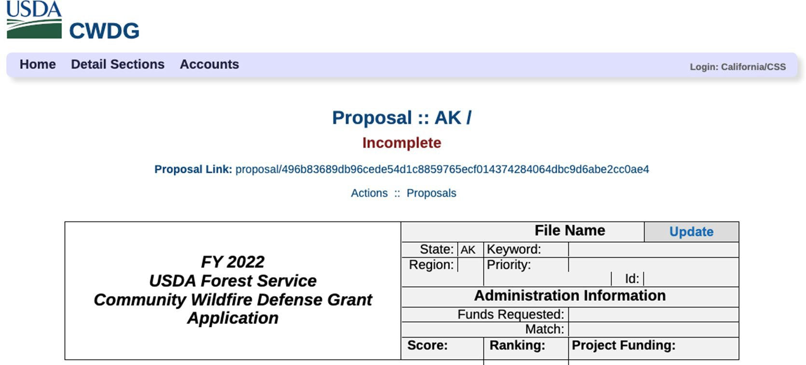
Application Link

Slide 60
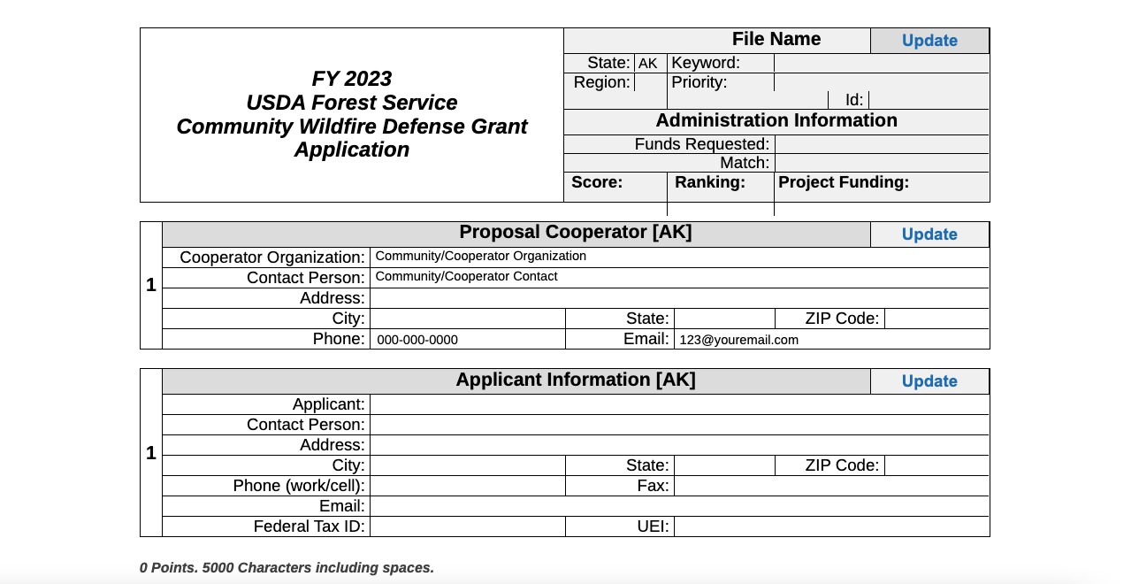
Admin Section and Applicant Section

Slide 61
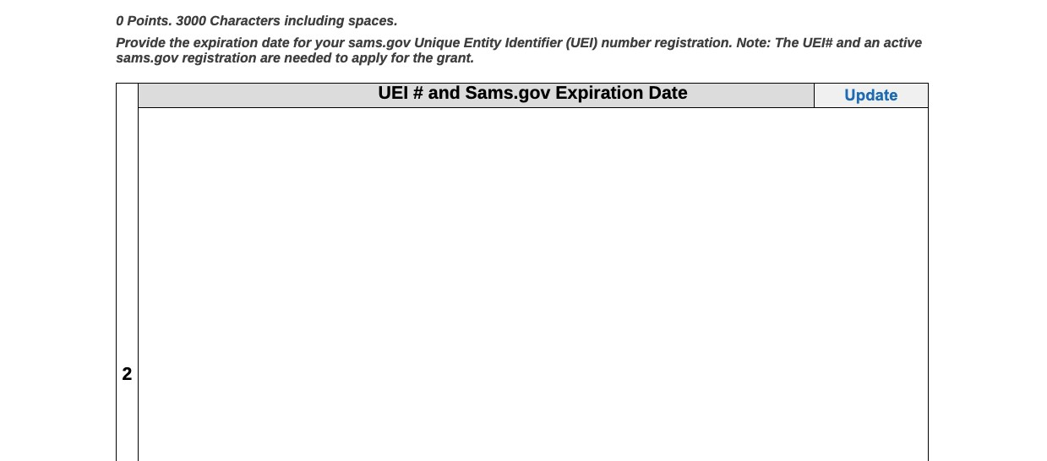
UEI# and Sams.gov Expiration Date

Slide 62
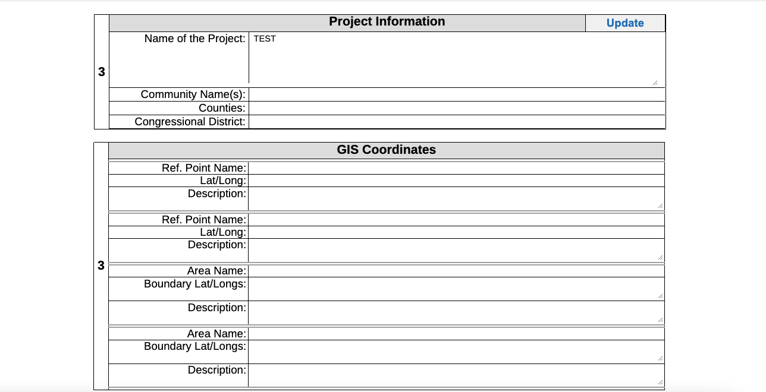
Project Information

Slide 63
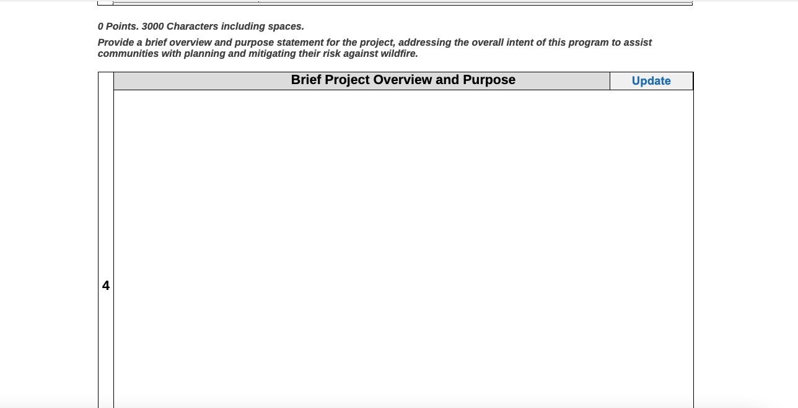
Brief Project Overview and Purpose

Slide 64
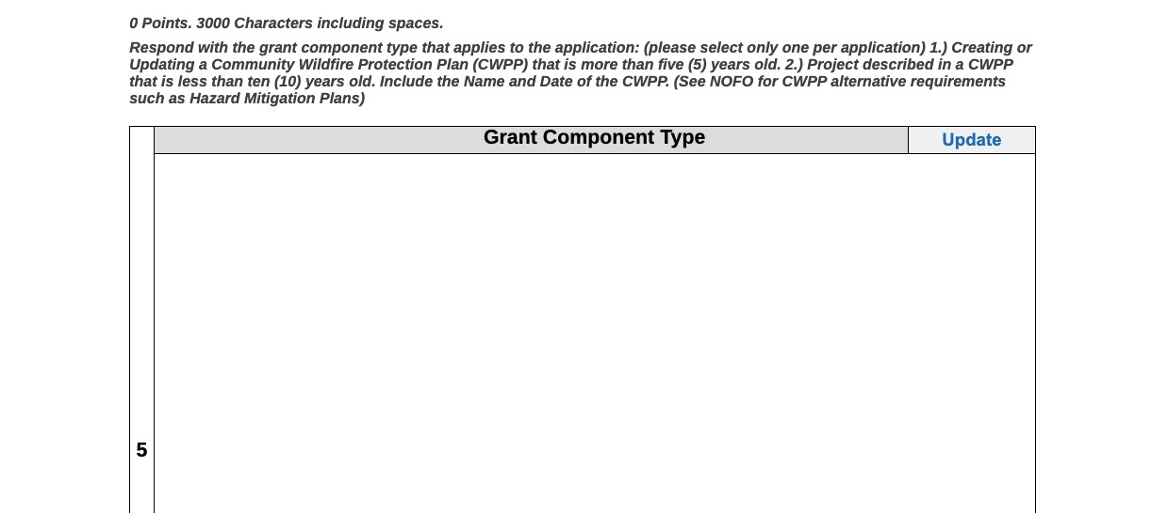
Grant Component Type

Slide 65
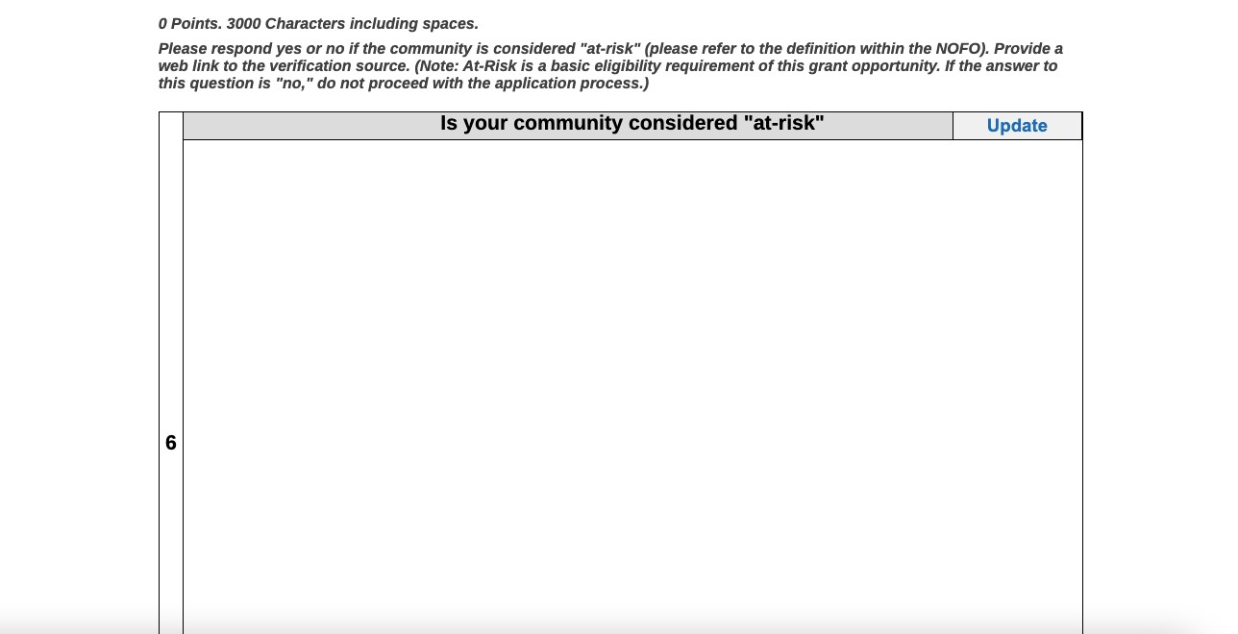
At-Risk Community

Slide 66
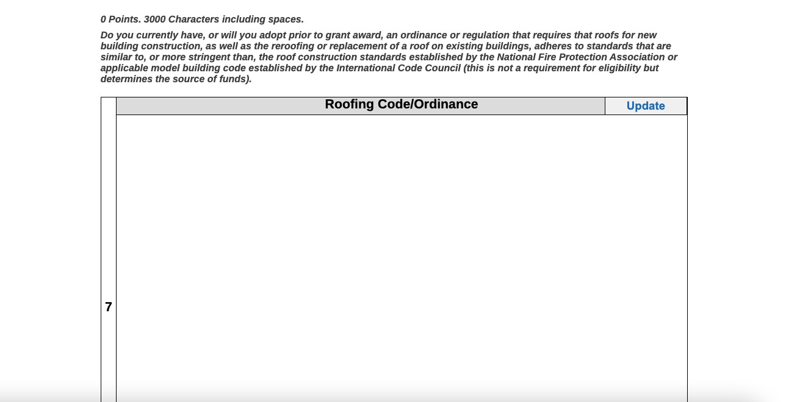
Roofing Code/ Ordinance

Slide 67
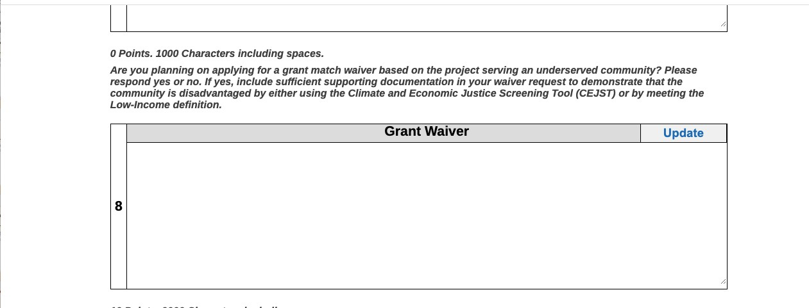
Grant Waiver

Slide 68
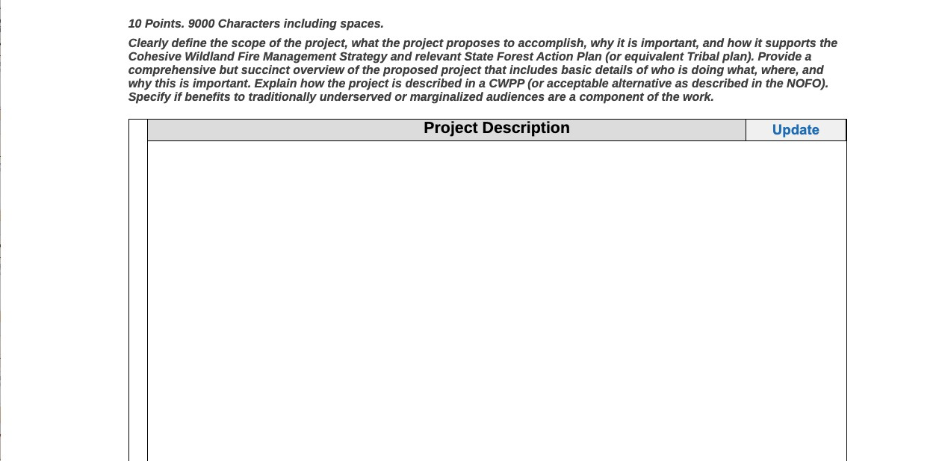
Project Description

Slide 69
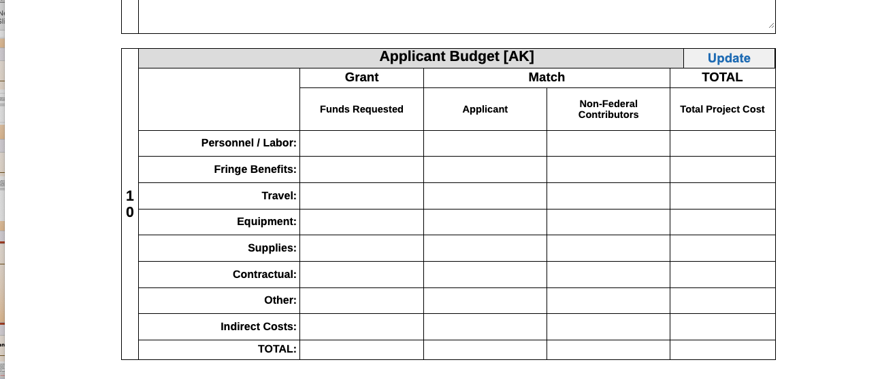
Applicant Budget

Slide 70
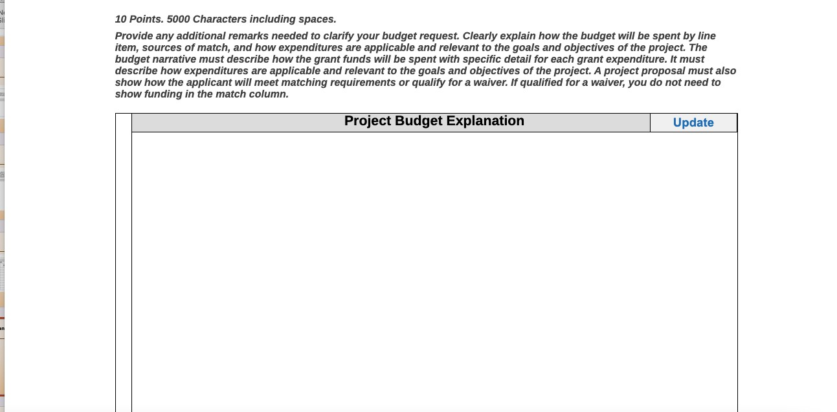
Project Budget Explanation

Slide 71
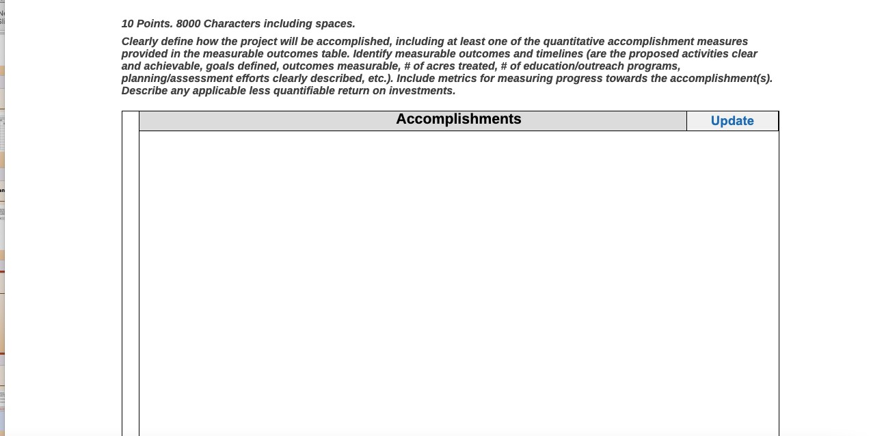
Accomplishments

Slide 72
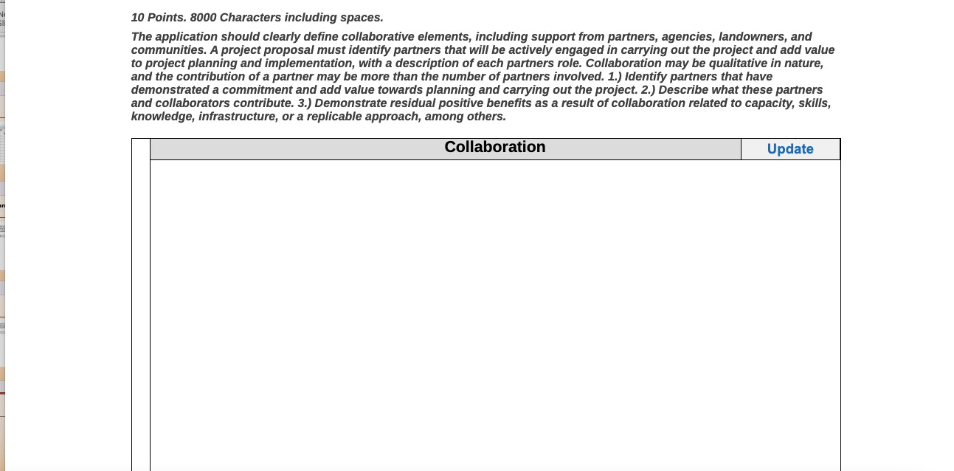
Collaboration

Slide 73
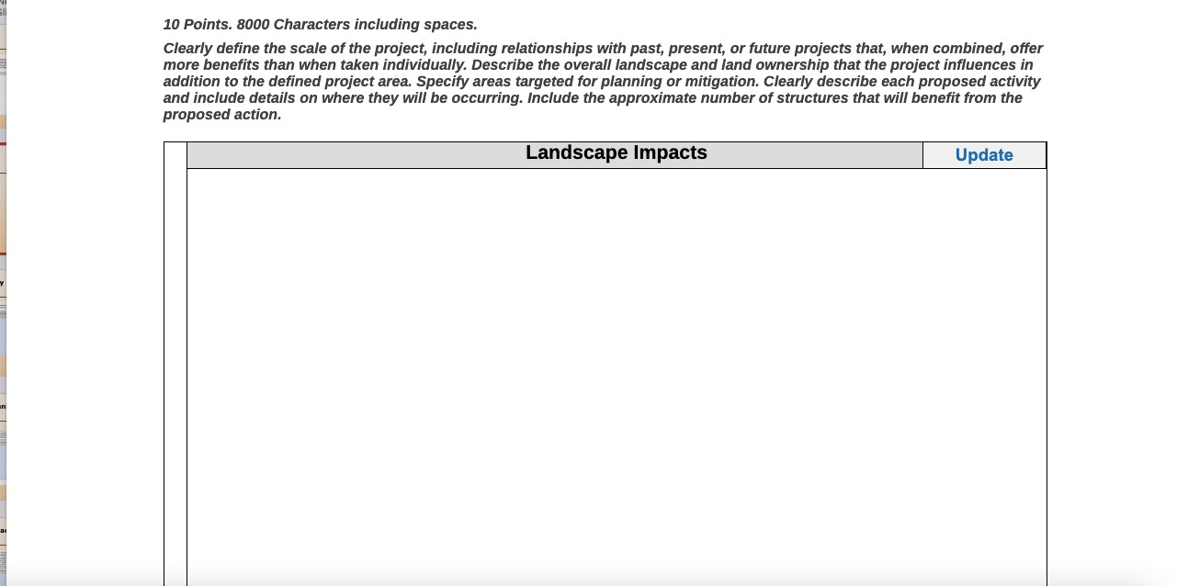
Landscape Impacts

Slide 74
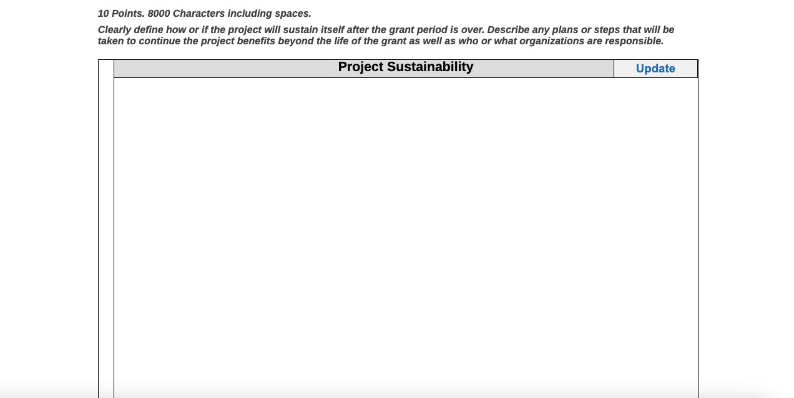
Project Sustainability

Slide 75
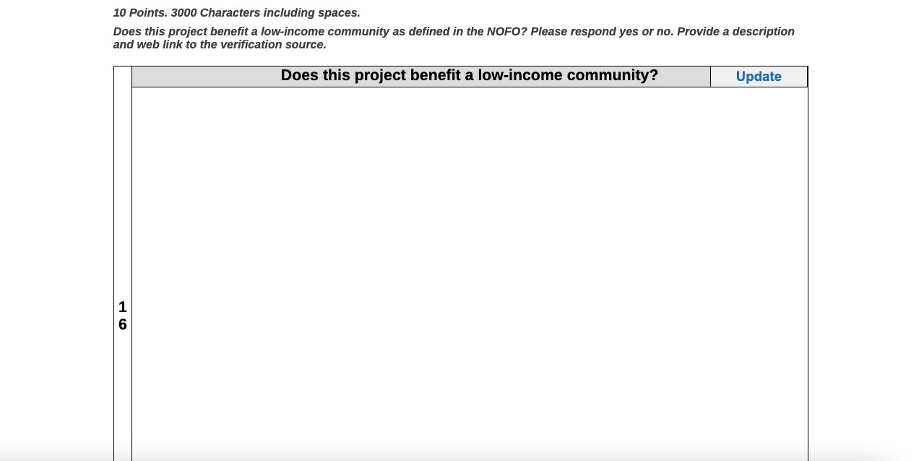
Low-Income Community

Slide 76
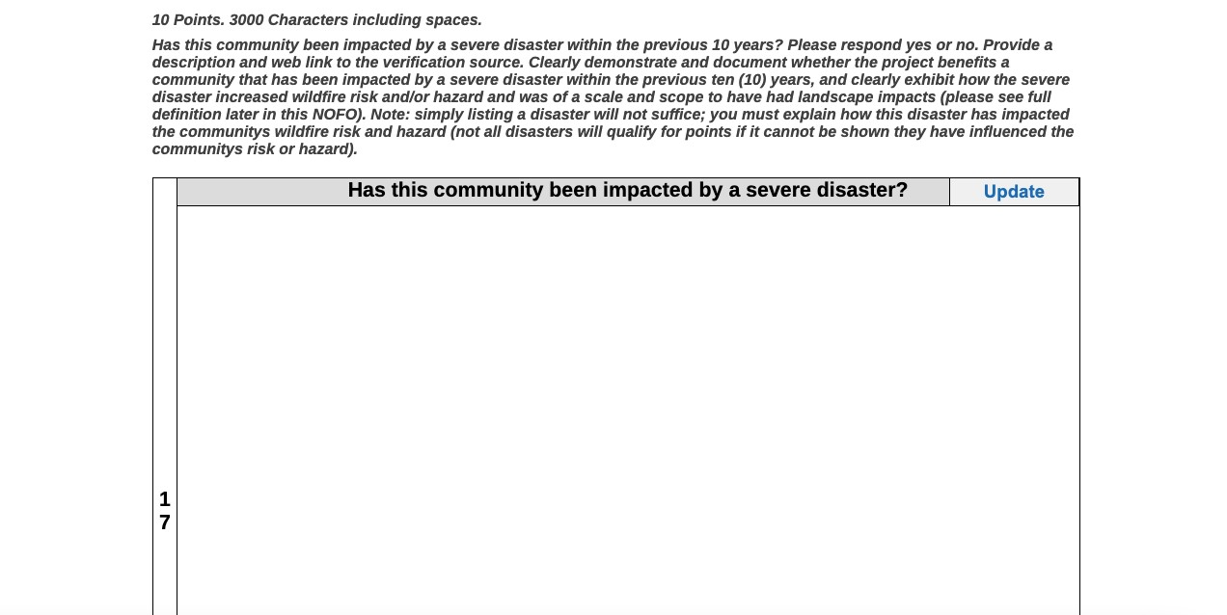
Severe Disaster Impact

Slide 77
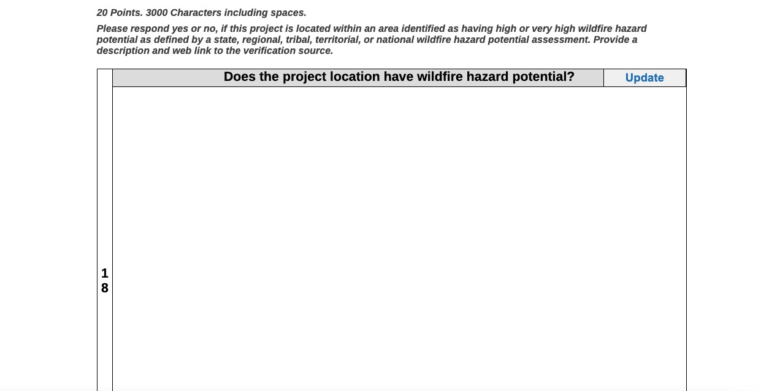
Wildfire Hazard Potential

Slide 78
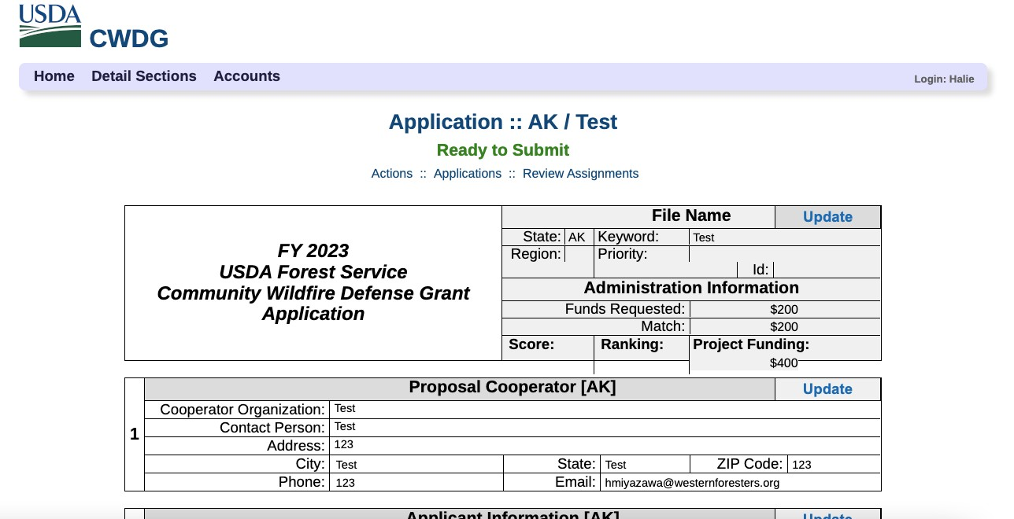
Review & Submit

Slide 79
Grants & Agreements

Slide 80
Grants & Agreements
Budget details
Cost share/match
Equipment
Buy American
Davis-Bacon wages for construction
Roads
Subawards – requirements and reporting
Sam.gov and risk

Slide 81
Grants & Agreements Access Branch Support
Goal:
Provide pre and post award technical and administrative assistance to external partners
Develop tools, resources and programs to improve access to Forest Service funding opportunities for traditionally underrepresented communities

Slide 82
Grants & Agreements Access Branch Support
Team:
Melissa Aulisio, Branch Chief
Rebecca Buxton, Outreach Collaboration Specialist
Aaron Stout, Grants Management Specialist
Robin Taylor Davenport, Outreach Collaboration Specialist
Heather Mansukhani, Access Coordinator
Vi Ta, Program Analyst
Contact:
Access Mailbox: accessga@usda.gov
Booking site for external partners: consultation site

Slide 83
CWDG Application: National Tools

Slide 84
Submitting Applications – CWDG Tool
An easy-to-use, online dashboard provides data to include in your CWDG application.
www.wildfirerisk.org/cwdg-tool
Immediate information about eligibility status
Populates key criteria (wildfire risk, low-income, and severe disaster declarations)
Cost-share waiver eligibility
GIS coordinates
Copy and paste options to easily populate your application

Slide 85
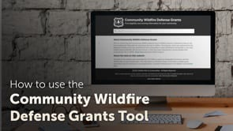
CWDG Tool Video

Slide 86
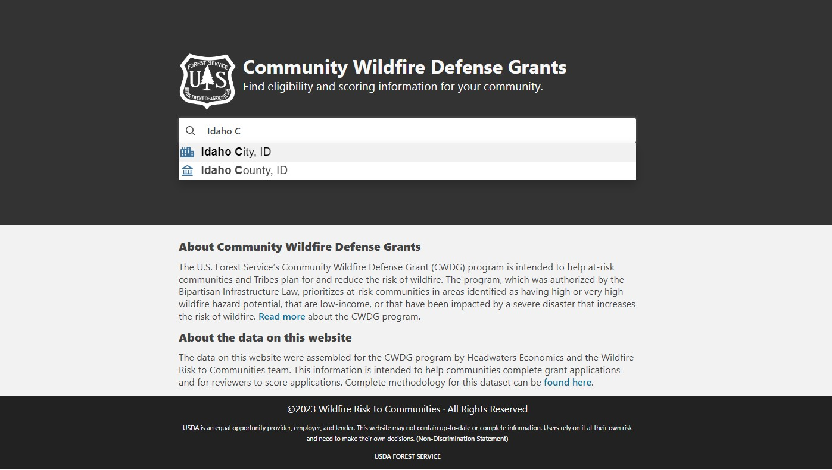
CWDG Online Tool – Step 1: Search

Slide 87
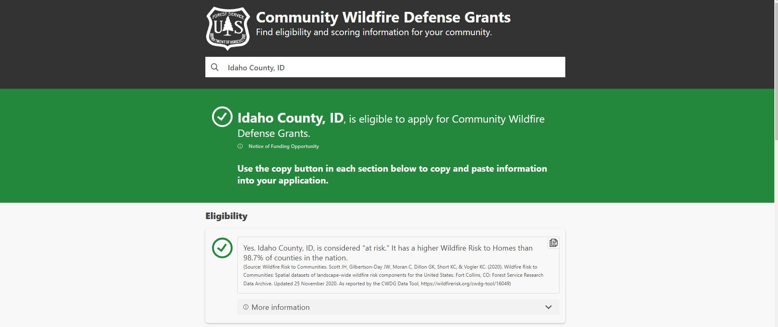
CWDG Online Tool – Step 2: Eligibility

Slide 88
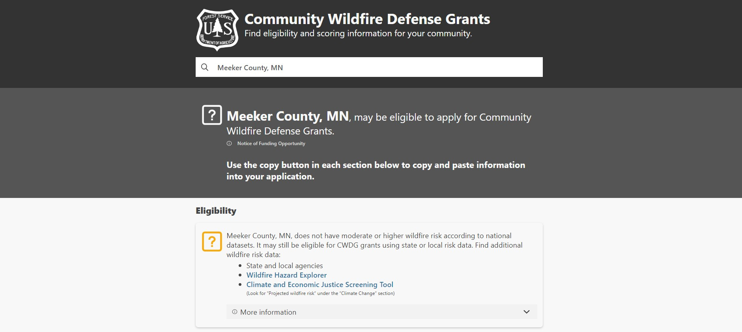
CWDG Online Tool – Step 2: Eligibility

Slide 89
CWDG Online Tool – Step 2: Eligibility

Slide 90
CWDG Online Tool – Step 2: Eligibility

Slide 91
CWDG Online Tool – Step 2: Eligibility

Slide 92
CWDG Online Tool – Step 3: GIS Coordinates

Slide 93
CWDG Online Tool – Step 4: Scoring (Low-Income)
…or

Slide 94
CWDG Online Tool – Step 4: Scoring (Low-Income)
…or

Slide 95
CWDG Online Tool – Step 4: Scoring (Severe Disasters)

Slide 96
CWDG Online Tool – Step 4: Scoring (Severe Disasters)

Slide 97
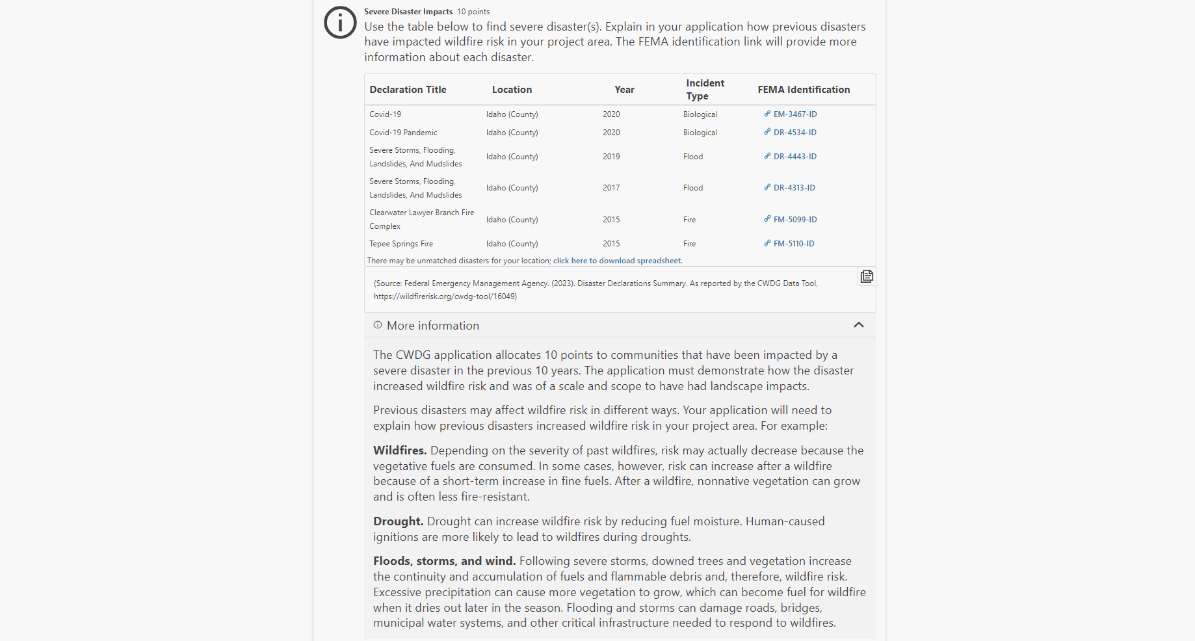
CWDG Online Tool – Step 3: Scoring

Slide 98
CWDG Online Tool – Step 4: Scoring (Wildfire Hazard)
…or

Slide 99
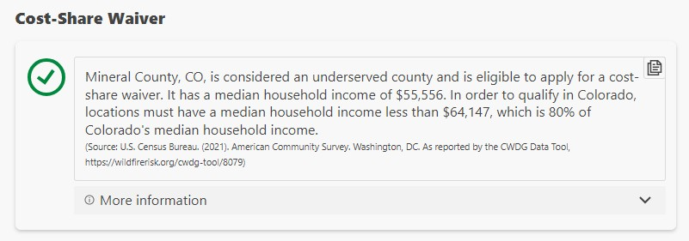
CWDG Online Tool – Step 5: Cost- Share Waiver
…or

Slide 100
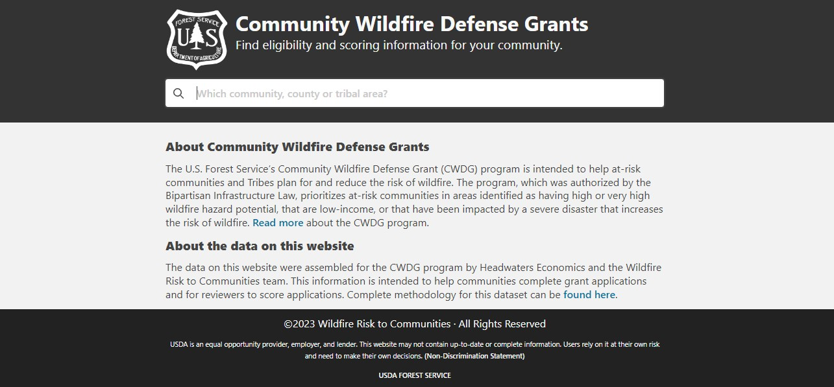
www.wildfirerisk.org/cwdg-tool

Slide 101
National Tools
CWDG Tool: https://wildfirerisk.org/cwdg-tool
Council of Environmental Quality Climate and Economic Justice Screening Tool: https://screeningtool.geoplatform.gov/en/#3/33.47/- 97.5
Updated and approved tools will be posted on CWDG website: Community Wildfire Defense Grant Program | US Forest Service (usda.gov)
FAQ's
Samples of high/low scoring questions
Webinar Recordings

Slide 102
Proposed Timeline of CWDG Program
8/4/23 - 8/15/23 – Applicant Webinars (4)
8/30/23 - 10/31/23 - Bi-Weekly Office Hours
10/31/23 – Close application period
12/01/23 – Have round 2 applications verified
01/31/24 – Have round 2 applications scored
02/16/24 – Final list of scored and ranked applications

Slide 103
Questions?

